Slide 1
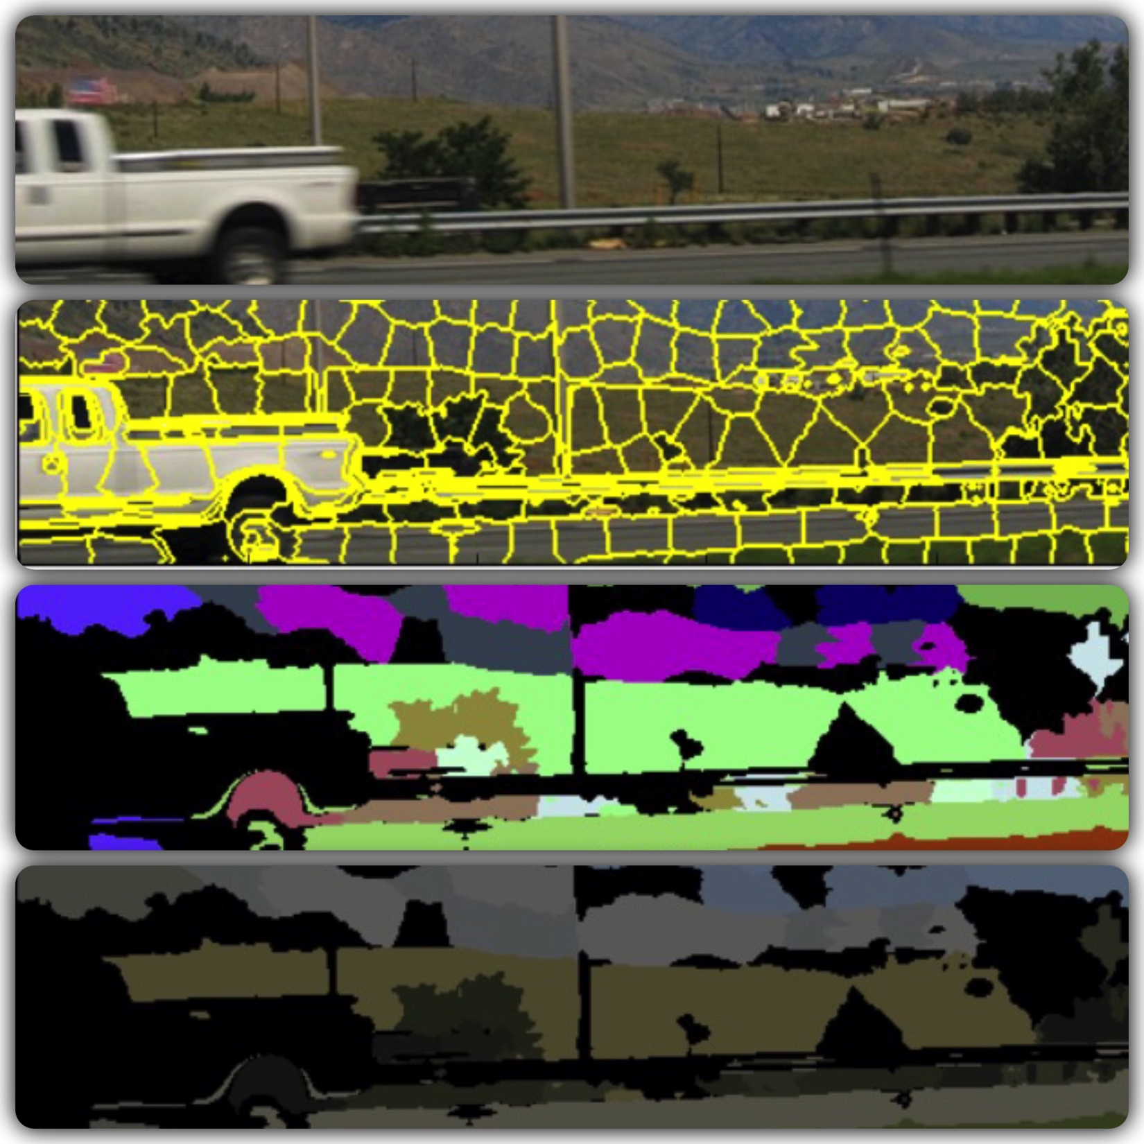

Image Classifier
Pixel Dawgs
NICK ROSETTI
VEERA KARRI
MANISH BORSE
SHREYA GUPTA

Slide 2
Overview
Introduction
Data Acquisition and Data Engineering
Image Processing
SLIC
DBSCAN
Sobel filtering
Machine Learning
GUI
Supervised learning using SVM
Results
Conclusion and Future work
Poster

Slide 3
Introduction
What is an Image Classifier?
A tool that will show what does a image have based on the visual content.
What can we achieve from that?
Simplification in categorizing the images.
Fast searching through images
Its really cool!!!

Slide 4
Data Acquisition and Data Engineering
Open source raw data is provided by Yahoo-Flickr.
Image URL (10 files, 5GB each).
File contains image ID and the associated url to download the file.
~300,000 images were downloaded.
Small subset was used due to computational limitation.
Auto-tags (14GB).
File contains image ID and associated auto-tags.
File was divided in two different files, because traditional processing was hard on such a large file.
Index column was changed to auto-tags, now all the auto-tags are associated with the image ID.

